Slide 1

Creating AMD Dijits for ArcGIS API for JavaScript
Matt Driscoll @driskull github.com/driskull
https://github.com/driskull/arcgis-dijit-sample-js
Notes:
I work in Esri Technical marketing
I get to build cool demos using our software. Mostly using the ArcGIS JS API
Also get to help development by building widgets
Originally learned JS, then jQuery, now Dojo.
I built these widgets using Dojo’s AMD syntax.
I actually started writing the geocoder as original dojo legacy syntax and then converted it to AMD then wrote the directions widget starting with AMD.

Slide 2
Asynchronous Module Definition (AMD)
Fewer global variables
Plays nice and can be used with other AMD libraries
Improvements
Asynchronous loading
Dependency handling
Notes:
What is AMD?
Assigns Local variables to your dependencies instead of using global namespaces
Just like Require.js
Not all dojo code is available in AMD. Some dojox and dijits are not converted yet. Should say on dojo API.
AMD modules can be used in a non AMD app as well. So you can still load your dijit with dojo.require.

Slide 3
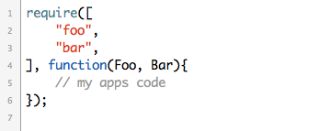
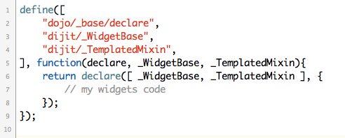
Dojo Loader
Require()
Define()
Notes:
These are the two global functions used for AMD.
Require, loads your dependencies before doing anything within the function.
Define is what you use to create an AMD Dijit.
Define specifies your dijit’s dependencies and returns your widget’s function to be used once the dependencies are loaded.
Basically, what happens is, resources are loaded and assigned to a local variable passed into the define or require function as arguments.
Order matters! Small gripe

Slide 4
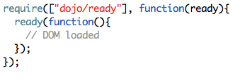

ready() and domReady!
Notes:
domReady! Is a shortcut for ready().

Slide 5
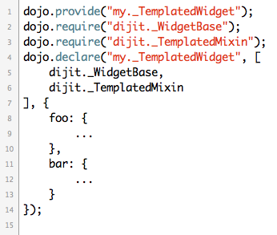
Legacy
Notes:
Here’s an example of the old legacy way of defining a custom module or widget.
You provide your widget and require all the dependencies but they are all assigned global variables so there is potential for conflicts if you’re using Dojo with another library.

Slide 6
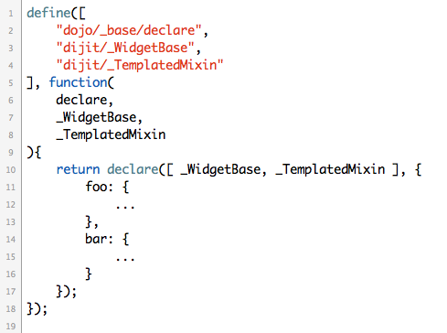
AMD
Notes:
Here’s the new AMD method.
All your dependencies are passed in as parameters to the define function so there is less potential for conflicts because there are less globals. Just require and define with full AMD in async mode.

Slide 7
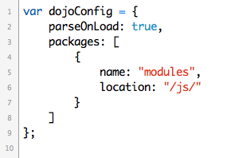
Dojo Config
Notes:
Setup your dojo config to point to your dijit.
You can define multiple packages.
Add packages to load custom modules and dijits

Slide 8
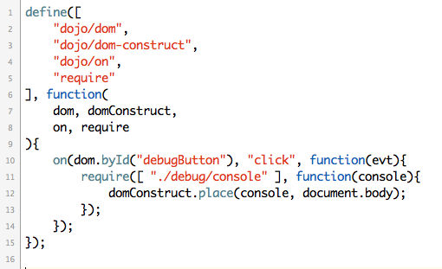
Conditional Require
Notes:
In this example, notice how there’s a require statement inside of the click event for this debug button.
Inside that, another dependency is loaded when a button is clicked.
So you can conditionally load dependencies using require

Slide 9
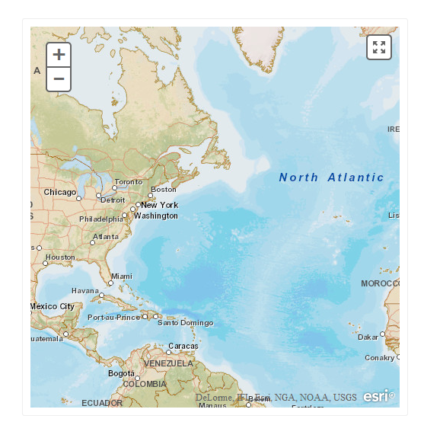
A Simple Dijit: HTML5 Fullscreen a Map
Notes:
Created a real simple djitit to walk through.
This dijit renders a button that toggles a map fullscreen using the browsers HTML5 fullscreen API.
The only thing we’re passing into the Dijit is a ArcGIS Map object.

Slide 10
Converting legacy code tips
Refer back to the latest Dojo API
Some functions deprecated or replaced
Use newer Dojo functions if available
Use new event handling with on()
Get/Set widget properties with .get() and .set()
watch() widget properties and call update functions
Always check the current Dojo API to see if the function has been deprecated/replaced.

Slide 11
?

Slide 12
http://esriurl.com/survey
Offering ID: 361
https://github.com/driskull/arcgis-dijit-sample-js

